Slide 1
NoSQL
Working with Semi-Structured data
Sagar Chhabriya
May 2, 2024

Slide 2


Where there is a computer, there is a database.

Slide 3
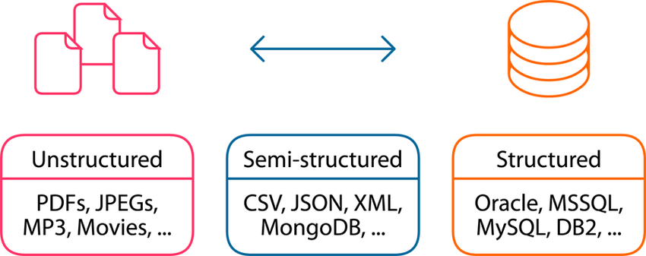
Structured, Semi-Structured, and Structured Data.

Slide 4
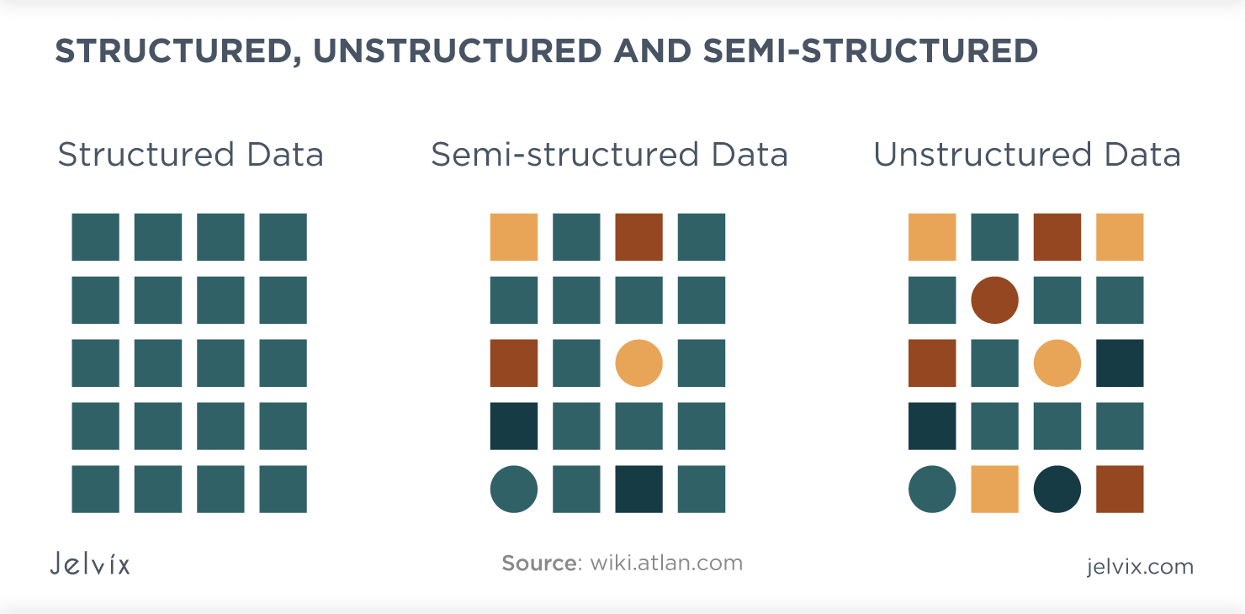
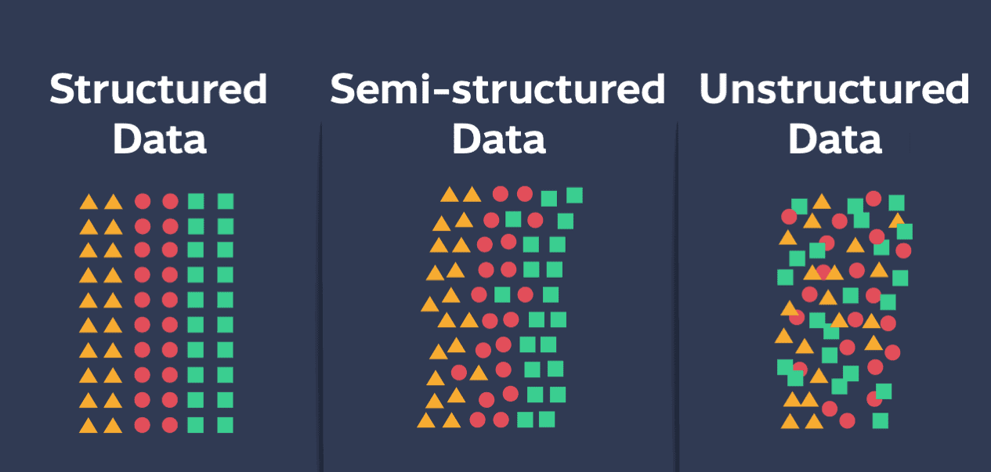

Slide 5
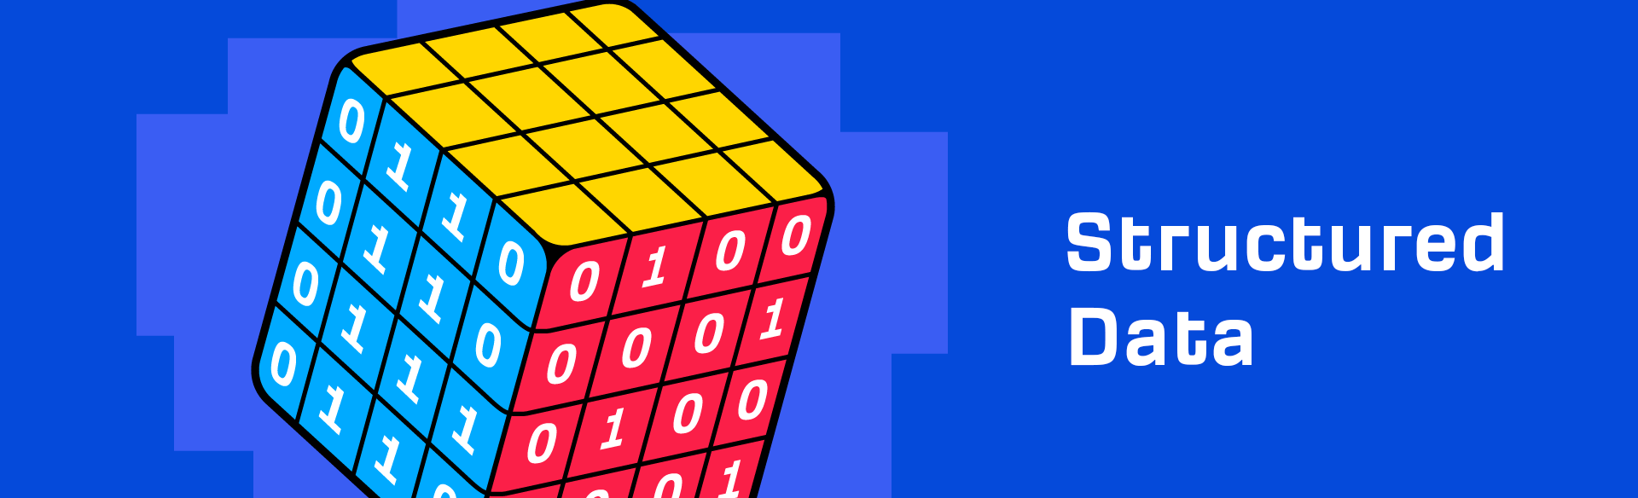
Most organized and conventional form of data.
Highly organized and stored in a tabular format, often resembling spreadsheets or databases.
Each piece of data is labeled and stored in rows and columns.
Ex:
  Information databases
  Financial records

Slide 6

Characteristics of Structured Data.
Organized: Data is stored in a structured format with predefined fields and data types.
Easy to analyze: The structured nature makes performing analysis using SQL or other query languages straightforward.
Well-suited for automation: Structured data can be processed and managed with minimal human intervention.
Common formats: CSV, SQL databases, and Excel spreadsheets are typical formats for structured data.

Slide 7
Semi-Structured Data
Falls between structured and unstructured data.
Often represented in formats like JSON, XML, etc.
It allows for more flexibility in data representation and can accommodate varying structures within the same dataset.

Slide 8
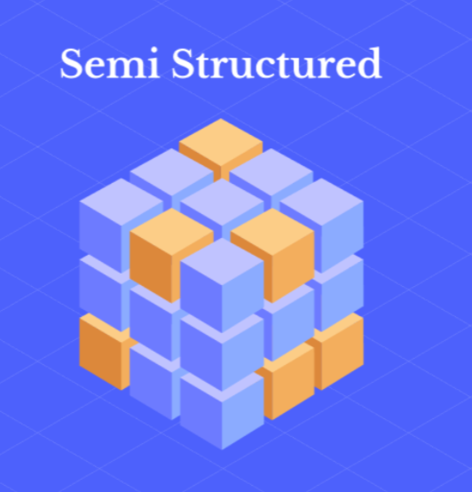
Characteristics of Semi-Structured Data
Flexible schema: Semi-structured data allows for a variable and flexible schema, making it suitable for evolving data sources.
Hierarchical: Data may be organized hierarchically with nested elements, making it useful for complex data relationships.
Common formats: JSON, and XML, are commonly used formats for semi-structured data.

Slide 9


I want to see the code of Semi-Structured…

Slide 10
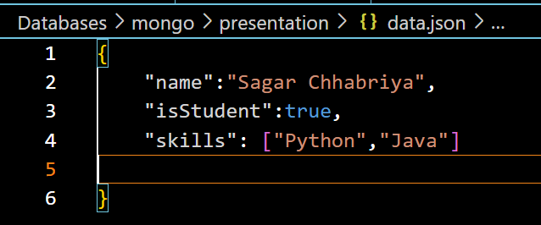
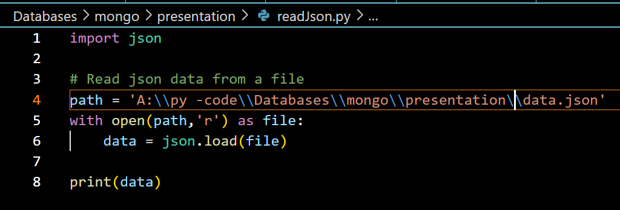
JSON
data.json
readJSON.py

Slide 11
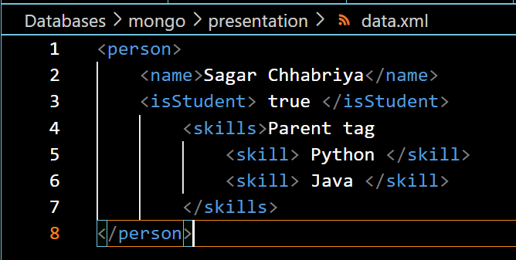
XML (Extensive Markup Language)

Slide 12
Unstructured Data
Unstructured data lacks a predefined structure and doesn’t fit into traditional rows and columns.
It comes in various formats like text, images, audio, and video.
Examples include social media posts, images, customer reviews, and audio recordings.

Slide 13
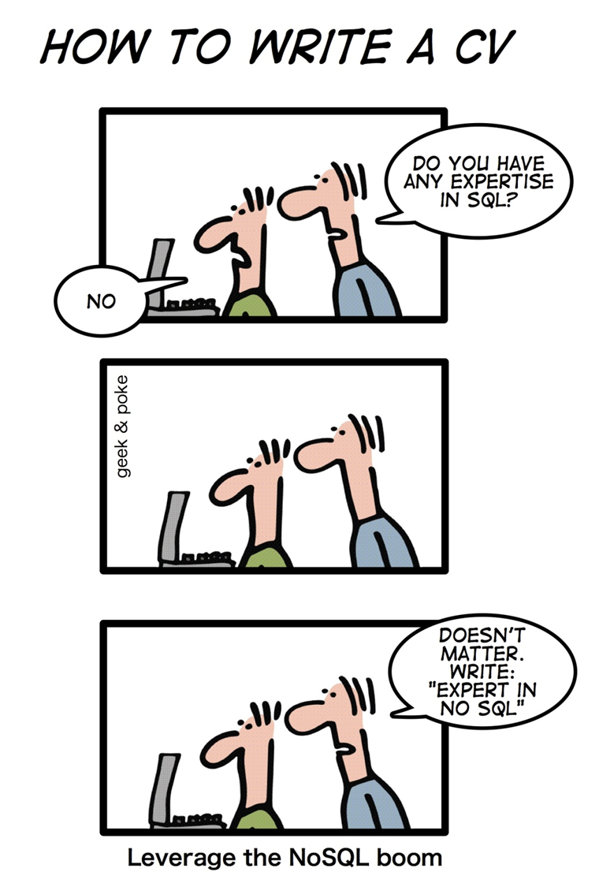
NoSQL!
NoSQL databases are currently a hot topic in some computing parts, with over a hundred different NoSQL databases.

Slide 14
What is NoSQL?
It stands for Not-Only-SQL
#NoSQL was a Twitter hashtag for a conference in 2009 used by ERIC EVANS.
It is a non-relational database.
Mainly designed to be used for big data and real-time web applications.
Do not require a fixed table schema nor do they use the concept of joins.
Relaxation for one or more of the ACID properties using the CAP theorem.

Slide 15
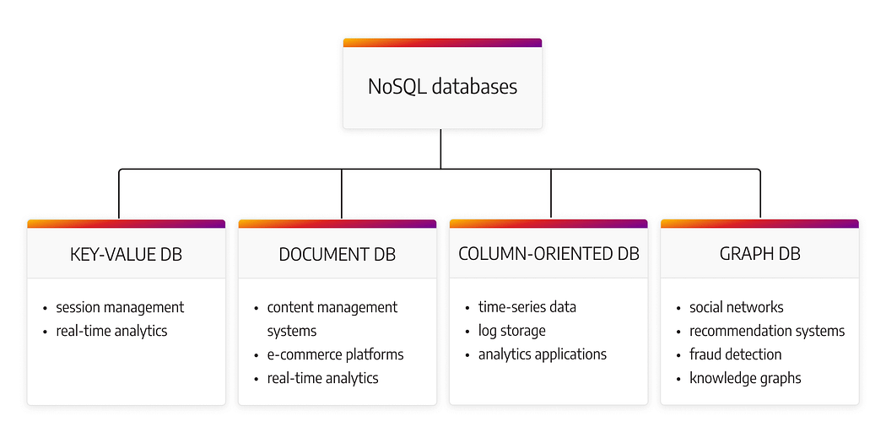
Types of NoSQL databases
Key-value databases
Document databases
Column family databases
Graph databases

Slide 16
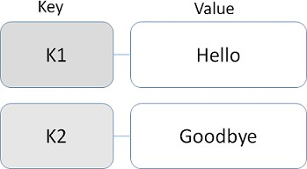
Key-value databases
Simplest NoSQL databases Get/Set values with associated key

Slide 17
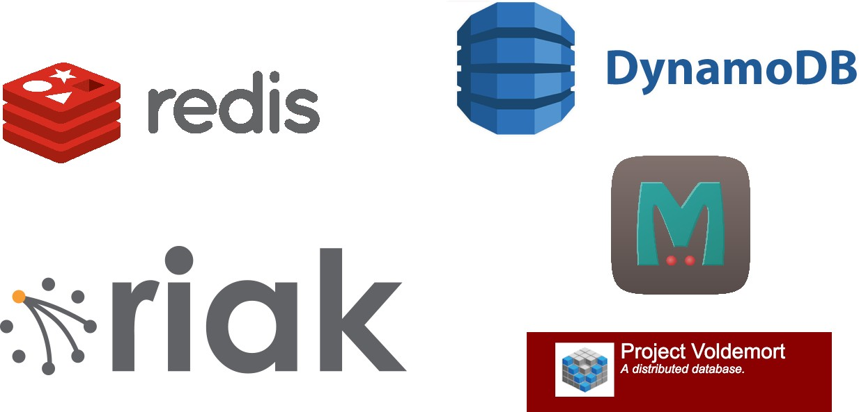
Popular key-value databases

Slide 18

Suitable cases
User sessions key: session ID
value: session information

Slide 19
Document database

Slide 20

Document database - overview

Slide 21
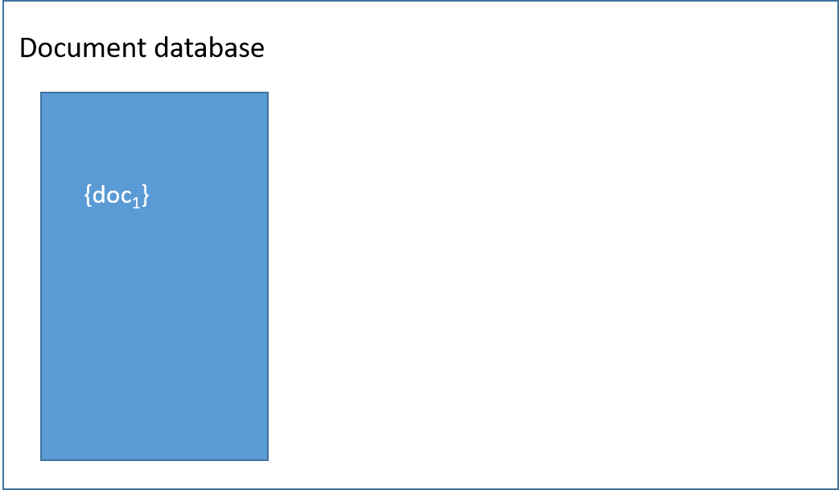
Document database - overview

Slide 22

Document database - overview

Slide 23

Document database - overview

Slide 24
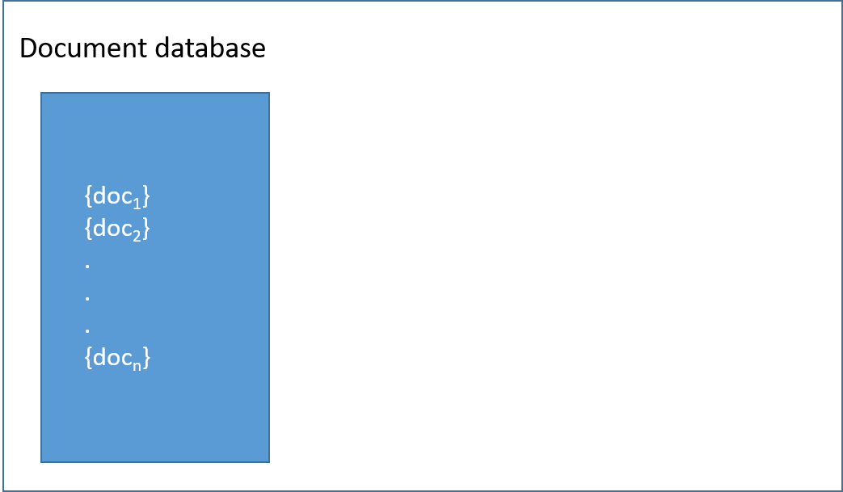
Document database - overview

Slide 25
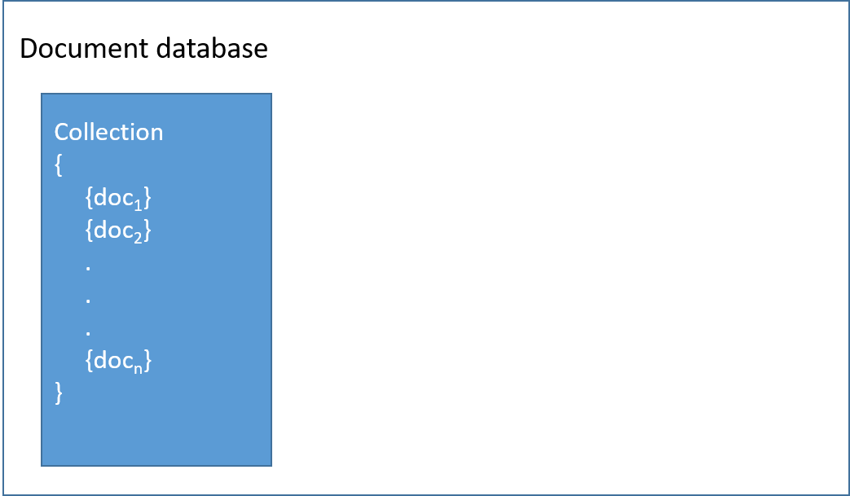
Document database - overview

Slide 26
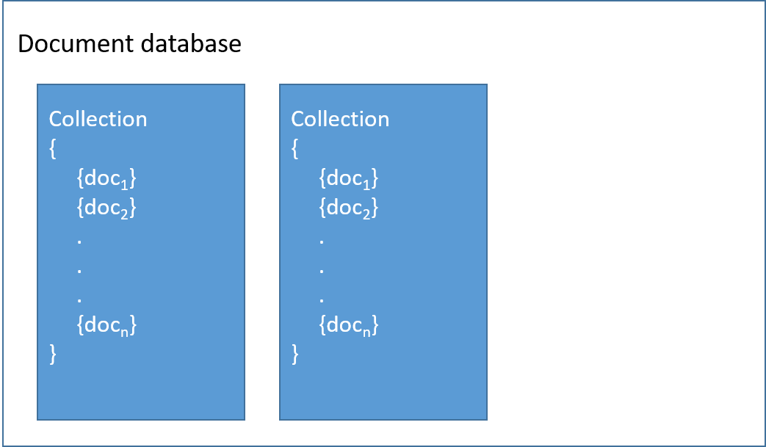
Document database - overview

Slide 27
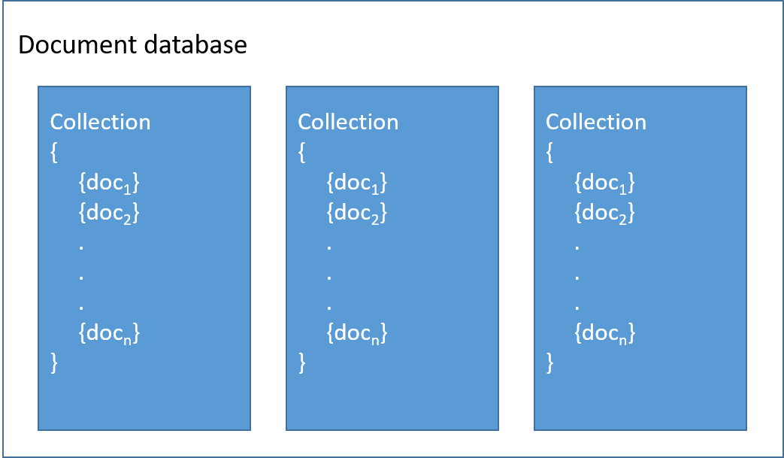
Document database - overview
Documents -> rows
Collections -> tables

Slide 28
Documents
Set of key-value pairs
Keys: strings
Values: numbers, strings, booleans, arrays or objects Schemaless: no need to specify the structure Formats: JSON, BSON, or XML

Slide 29
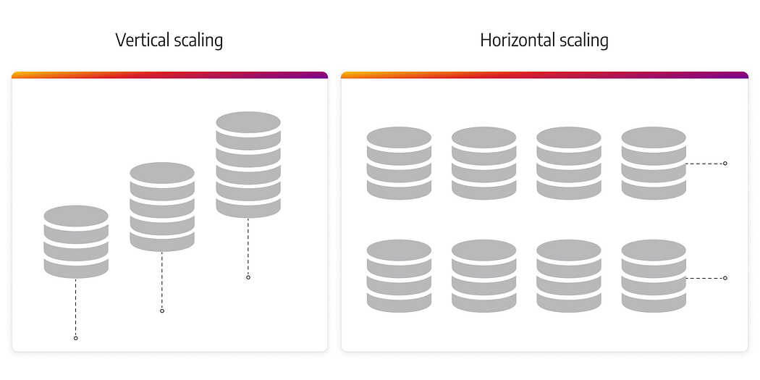
Why NoSQL
Distributed Systems
Vertical Scaling VS Horizontal Scaling

Slide 30
When NoSQL
1. Handling large volumes of data at scale seamlessly
2. Working easily with unstructured or semi-structured data
3. Enabling rapid development
4. High read/write speed
5. Managing complex relationships

Slide 31
Let’s interact with MongoDB using Python.
Connect Client locally.
Create | Read Databases AND Collections.
Create | Add | Read Documents.
Update Documents | Collections | Databases.
Delete Documents | Collections | Databases.

Slide 32
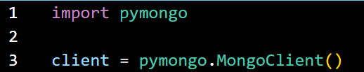
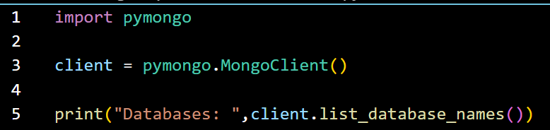
1. Connect Client and Print default DBs.
2. Read default Databases.
In MongoDB, a database is not created until it gets content!

Slide 33
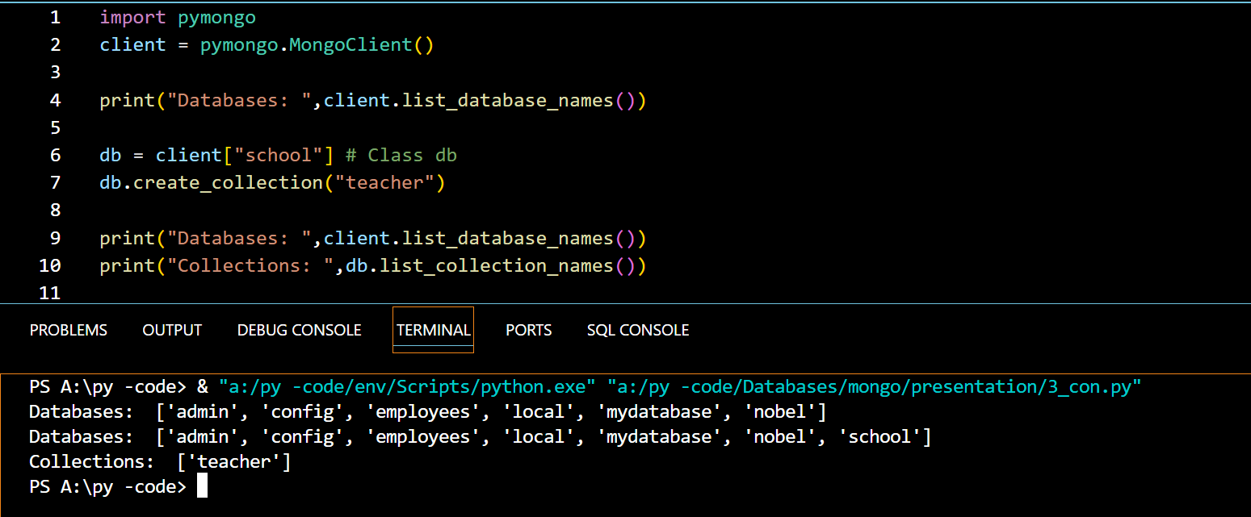
Create school Database and teacher collection.
Note: If you try to insert documents into a collection that does not exist, MongoDB will create the collection automatically.

Slide 34
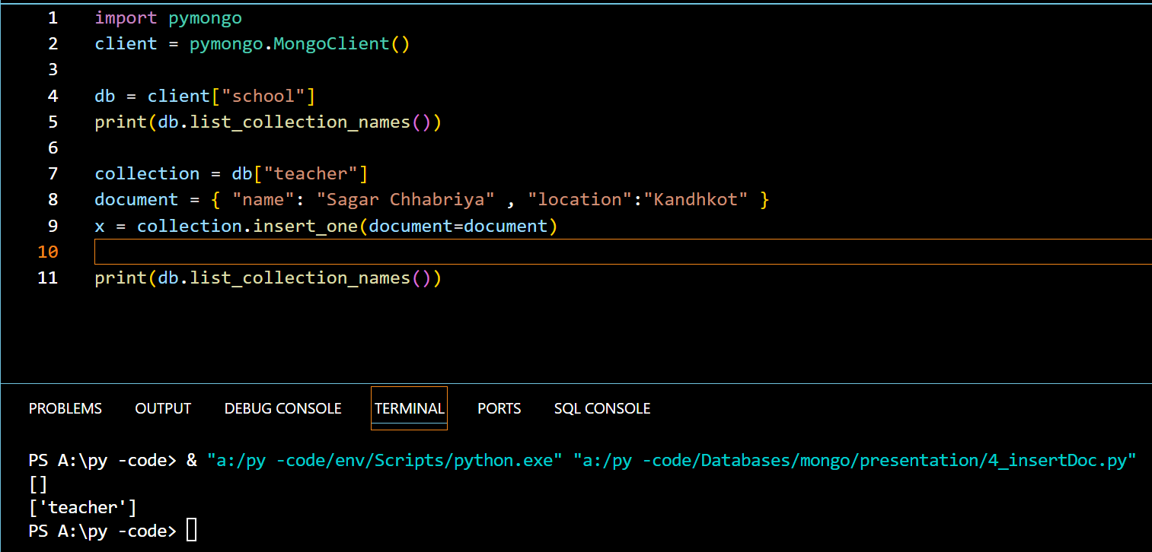
Insert a document.

Slide 35
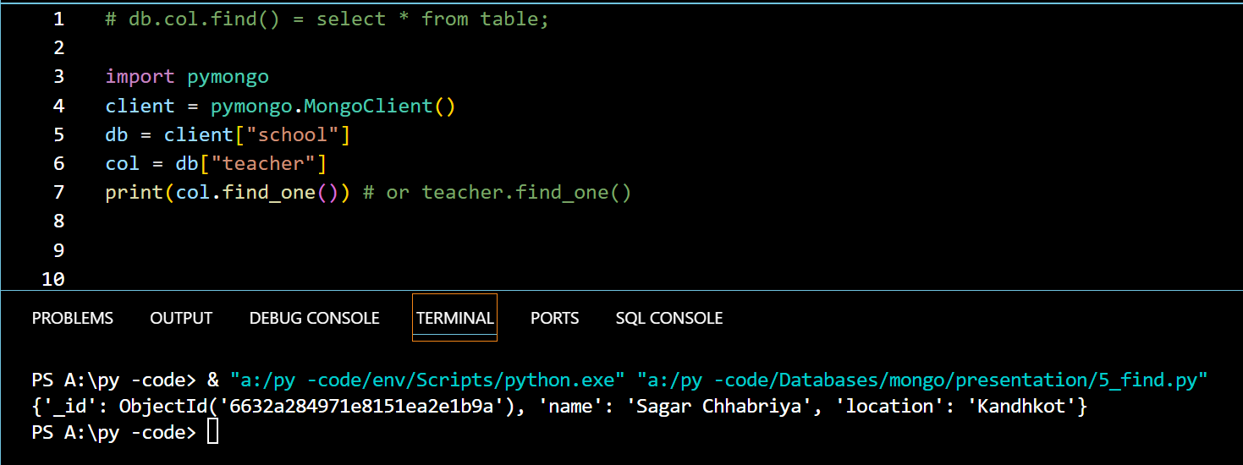
Retrieve documents.

Slide 36
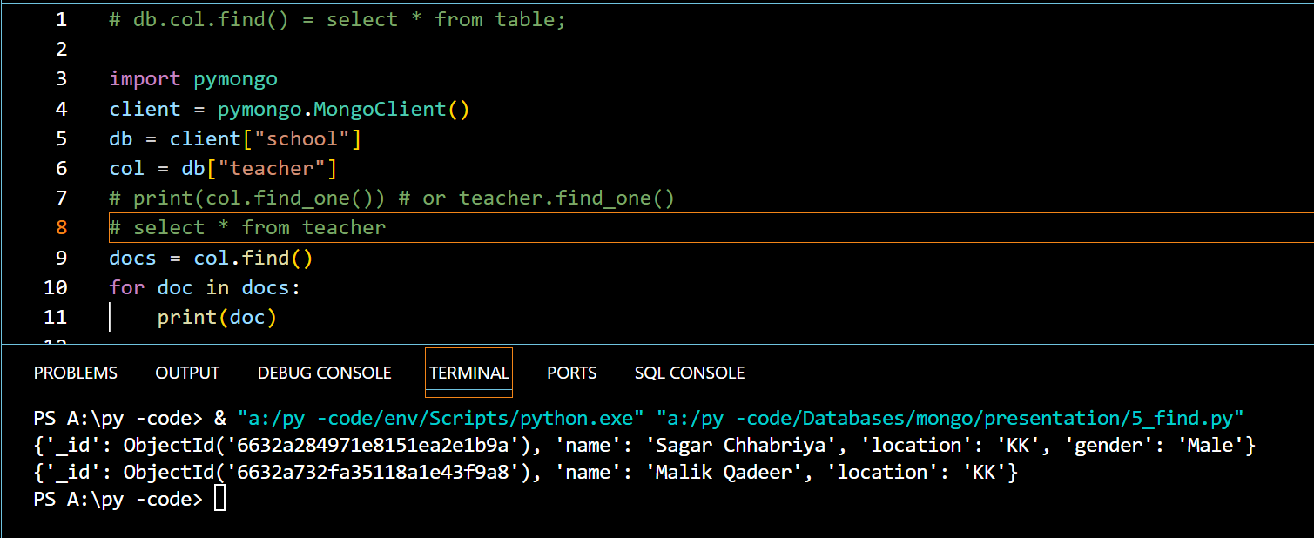

Slide 37
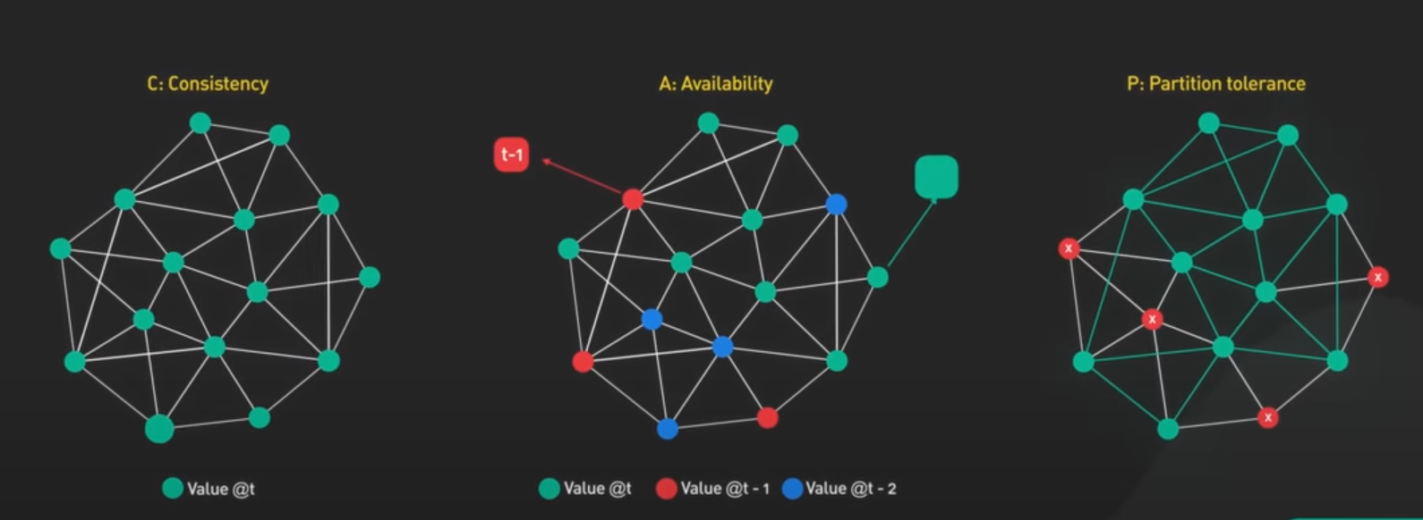
CAP Theorem

Slide 38
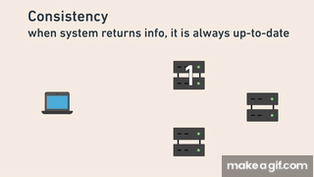

Slide 39
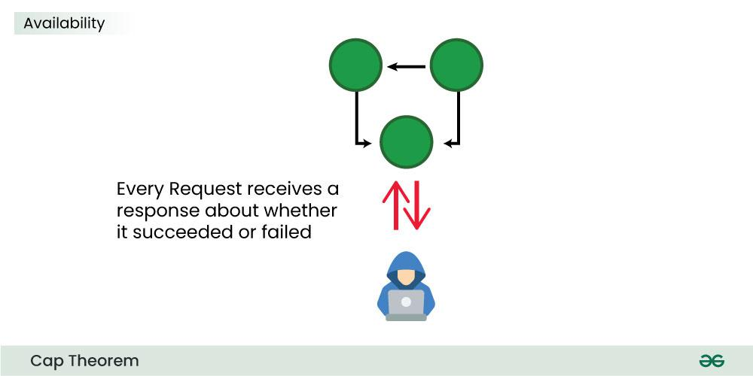

Slide 40

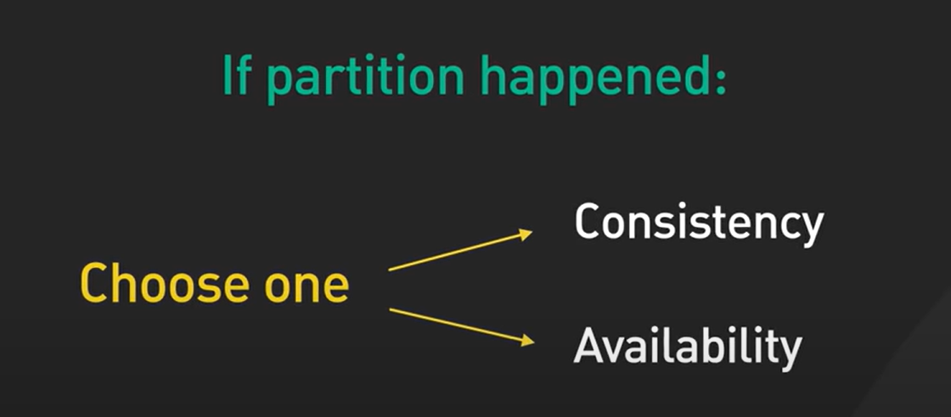
Network Failure: Partition Tolerance

Slide 41
Advantages of NoSQL
Cheap and easy to implement (Open Source)
Data are replicated to multiple nodes (fault tolerance)
When data is written, the latest version is on at least one node and then replicated to other nodes.
Easy to distribute.
Don’t require a schema.

Slide 42
Where to use NoSQL
NoSQL Data storage makes sense for applications that process very large semi-structured data –like log Analysis, Social Networking feeds, etc.
To improve programmer productivity using a database that matches an application’s needs better.

Slide 43
Research Challenges
Transaction Processing: NoSQL does not strictly follow ACID properties.
Query Processing: There is no user friendly unified query language for NoSQL.

Slide 44
Thank You

